Slide 1
TYPES. COERCION. EQUALITY.
by Ostap Kovbasiuk

Slide 2
DATA TYPES
Number
Boolean
Null
Undefined
Object
String
Symbol

Slide 3
NUMBER
The number data type is used to represent positive or negative numbers with or without decimal place numbers, numbers written using exponential notation e.g. 1.5e-4 (equivalent to 1.5x10⁻⁴), +-Infinity and NaN (not a number).

Slide 4
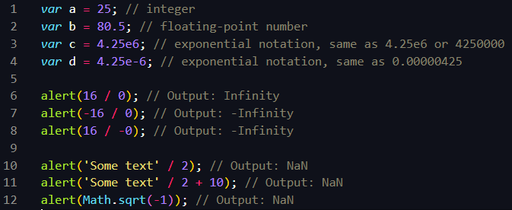
NUMBER EXAMPLES

Slide 5
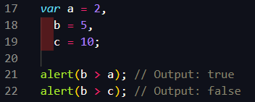
BOOLEAN
The Boolean data type can hold only two values: true or false.

Slide 6
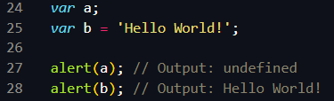
UNDEFINED
The undefined data type can only have one value-the special value undefined. If a variable has been declared, but has not been assigned a value, has the value undefined.

Slide 7
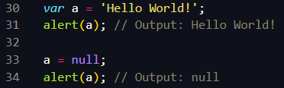
NULL
This is another special data type that can have only one value null. A null value means that there is no value. It is not equal to an empty string “” or 0, it is just nothing. A variable can be explicitly emptied of its current contents by assigning it the null value.

Slide 8
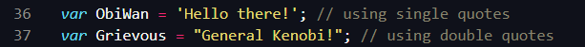
STRING
The string data type is used to represent sequences of characters and special characters. Strings are created using single/double quotes or backtick surrounding one or more characters.

Slide 9
ESCAPE NOTATION (SPEC CHARS)
\XXX (where XXX is 1–3 octal digits; range of 0–377) ISO-8859-1
\’
\`
\“
\\
\n
\r
\v
\t
\b
\f
\uXXXX (where XXXX is 4 hex digits; range of 0x0000 - 0xFFFF) UTF-16
\u{X} … \u{XXXXXX} (where X…XXXXXX is 1–6 hex digits; range of 0x0 – 0x10FFFF) UTF-32
\xXX (where XX is 2 hex digits; range of 0x00) ISO-8859-1
Notes:
\XXX (where XXX is 1–3 octal digits; range of 0–377)ISO-8859-1 character / Unicode code point between U+0000 and U+00FF
\’ single quote
\` backtick
\“ double quote
\\ backslash
\n new line
\r carriage return
\v vertical tab
\t tab
\b backspace
\f form feed
\uXXXX (where XXXX is 4 hex digits; range of 0x0000–0xFFFF)UTF-16 code unit / Unicode code point between U+0000 and U+FFFF
\u{X} ... \u{XXXXXX} (where X…XXXXXX is 1–6 hex digits; range of 0x0–0x10FFFF)UTF-32 code unit / Unicode code point between U+0000 and U+10FFFF
\xXX (where XX is 2 hex digits; range of 0x00–0xFF)ISO-8859-1 character / Unicode code point between U+0000 and U+00FF

Slide 10
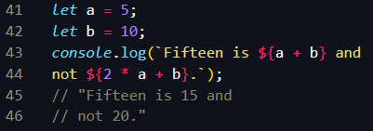
TEMPLATE STRINGS
Template literals are string literals written between backticks allowing embedded expressions.

Slide 11
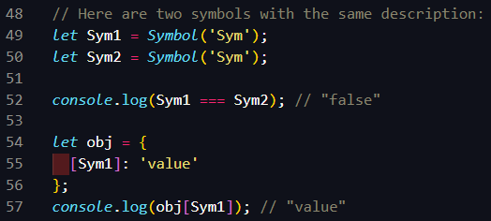
SYMBOL
In a JavaScript runtime environment, a symbol value is created by invoking the function Symbol, which dynamically produces an anonymous, unique value. A symbol may be used as an object property.

Slide 12
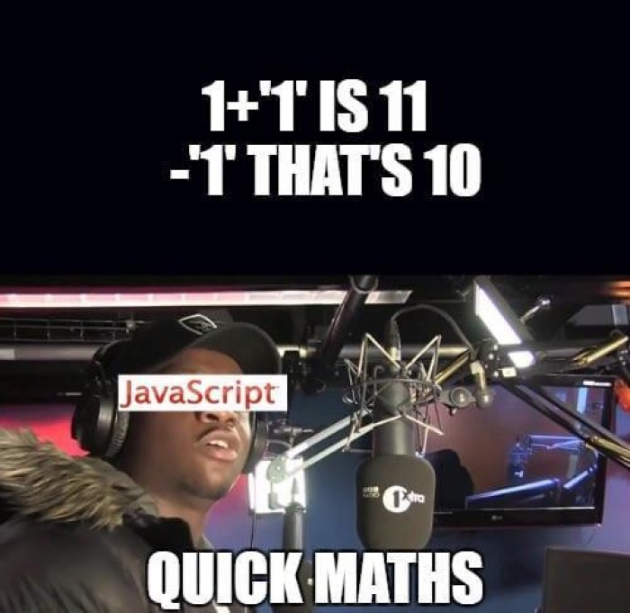
TYPES COERCION
It is the process of converting value from one type to another (such as string to number, object to boolean, and so on). Any type, be it primitive or an object, is a valid subject for type coercion

Slide 13
EXPLICIT/IMPLICIT COERCION
When a developer expresses the intention to convert between types by writing the appropriate code, like Number(value), it’s called explicit type coercion (or type casting).
Since JavaScript is a weakly-typed language, values can also be converted between different types automatically, and it is called implicit type coercion. It usually happens when you apply operators to values of different types, like 1 == null , 2 / ’5’ , or it can be triggered by the surrounding context, like with if (value) { … } , where value is coerced to boolean

Slide 14
CONVERSION TYPES
to string
to boolean
to number

Slide 15
STRING CONVERSION
String(123) // ‘123’ (explicit)
String(null) // ‘null’ (works for undefined, bools, negatives, also explicit)
String(Symbol(‘my symbol’)) // ‘Symbol(my symbol)’
‘ ‘ + (Symbol(‘my symbol’) // TypeError is thrown
123 + ‘ ’ // ‘123’ (implicit)

Slide 16
BOOLEAN CONVERSION
Boolean(2) // true (explicit)
Boolean(NaN) // false (explicit) same for null, undefined
Boolean({}) // true (explicit) same for [], function,Symbol()
if (2) { … } // true (implicit due to logical context)
!2 // false (implicit due to logical operator (also ||, &&,))

Slide 17
NUMERIC CONVERSION
Number(value) // NaN or number (explicit)
Comparison operators ( > , < , <= , >= ) (implicit)
Bitwise operators ( | , & , ^ , ~ ) (implicit)
Arithmetic operators ( - , + , * , / , %)
Unary + operator
Loose equality operator == (and !=)
Symbol cannot be converted to number

Slide 18
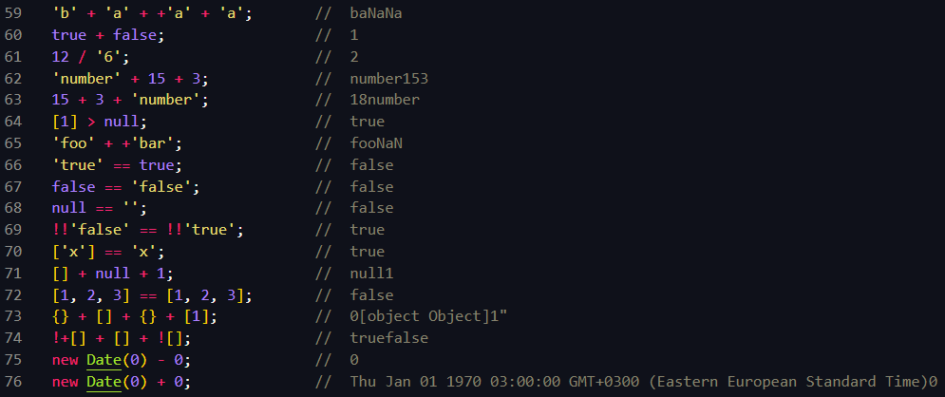
TYPES COERCION
Notes:
'b' + 'a' + +'a' + 'a'; // baNaNa
true + false; // 1
12 / '6'; // 2
'number' + 15 + 3; // number153
15 + 3 + 'number'; // 18number
[1] > null; // true
'foo' + +'bar'; // fooNaN
'true' == true; // false
false == 'false'; // false
null == ''; // false
!!'false' == !!'true'; // true
['x'] == 'x'; // true
[] + null + 1; // null1
[1, 2, 3] == [1, 2, 3]; // false
{} + [] + {} + [1]; // 0[object Object]1"
!+[] + [] + ![]; // truefalse
new Date(0) - 0; // 0
new Date(0) + 0; // Thu Jan 01 1970 03:00:00 GMT+0300 (Eastern European Standard Time)0

Slide 19
ABSTRACT/STRICT EQUALITY
== Abstract Equality Comparison ("loose equality", "double equals")
=== Strict Equality Comparison ("strict equality", "identity", "triple equals")
Object.is( val1, val2 ) provides SameValue (new in ES2015)

Slide 20
ABSTRACT/STRICT EQUALITY
Double equals will perform a type conversion when comparing two things (special handling for NaN, -0 , +0)
Triple equals will do the same comparison as double equals but without type conversion (special handling for NaN, -0 , +0)
Object.is does no type conversion and no special handling for NaN, -0 , +0

Slide 21
USEFUL LINKS
https://www.freecodecamp.org/news/js-type-coercion-explained-27ba3d9a2839/
https://medium.com/@sergeybulavyk/%D0%BF%D1%80%D0%B5%D0%BE%D0%B1%D1%80%D0%B0%D0%B7%D0%BE%D0%B2%D0%B0%D0%BD%D0%B8%D0%B5-%D1%82%D0%B8%D0%BF%D0%BE%D0%B2-%D0%B2-javascript-35a15ddfc333
https://developer.mozilla.org/uk/docs/Web/JavaScript/Data_structures
https://developer.mozilla.org/en-US/docs/Web/JavaScript/Equality_comparisons_and_sameness
https://dorey.github.io/JavaScript-Equality-Table/

Slide 22
THANK YOU

